Slide 1
01
Validating ID Submissions using Machine Vision
Improving the customer experience in applying for a new digital bank account

Slide 2
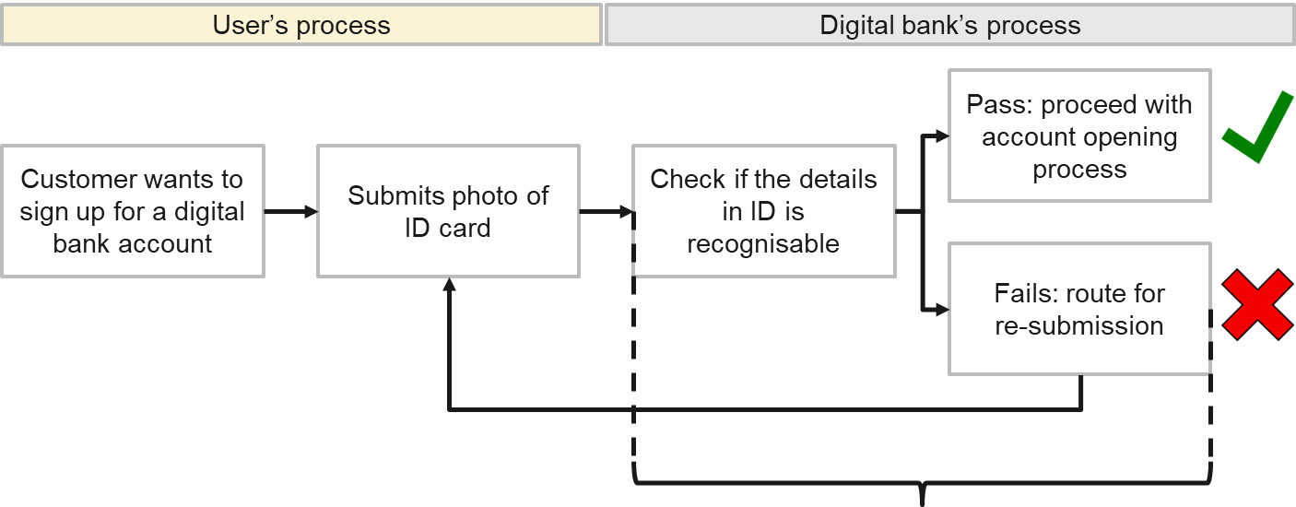
Problem Statement
A digital bank in Singapore wants to shorten its account opening process by automating its customer identification (ID) validation process. Currently:
Processing time: 3 – 5 working days*
*For reference: an incorrect photo submission to Singapore’s ICA may double the process time (Straits Times): 2 weeks for NRIC, 4 weeks for passport (ICA)

Slide 3
Goal
Using machine vision, automatically and quickly evaluate the submitted photo with the digital bank’s photo guidelines:
Processing time: <1 min
Challenge: multiclass object detection in images

Slide 4
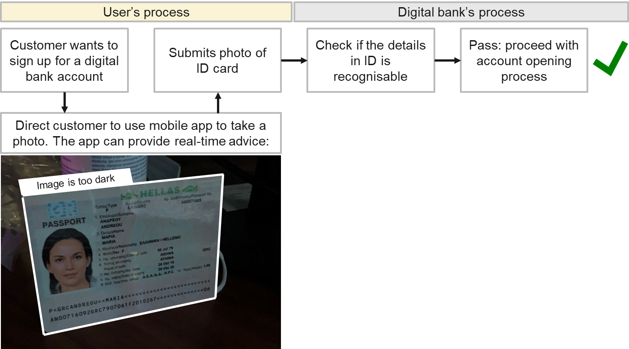
*Stretch Goal*
Using machine vision, automatically and quickly evaluate the submitted photo with the digital bank’s photo guidelines:
Challenge: multiclass object detection in videos

Slide 5
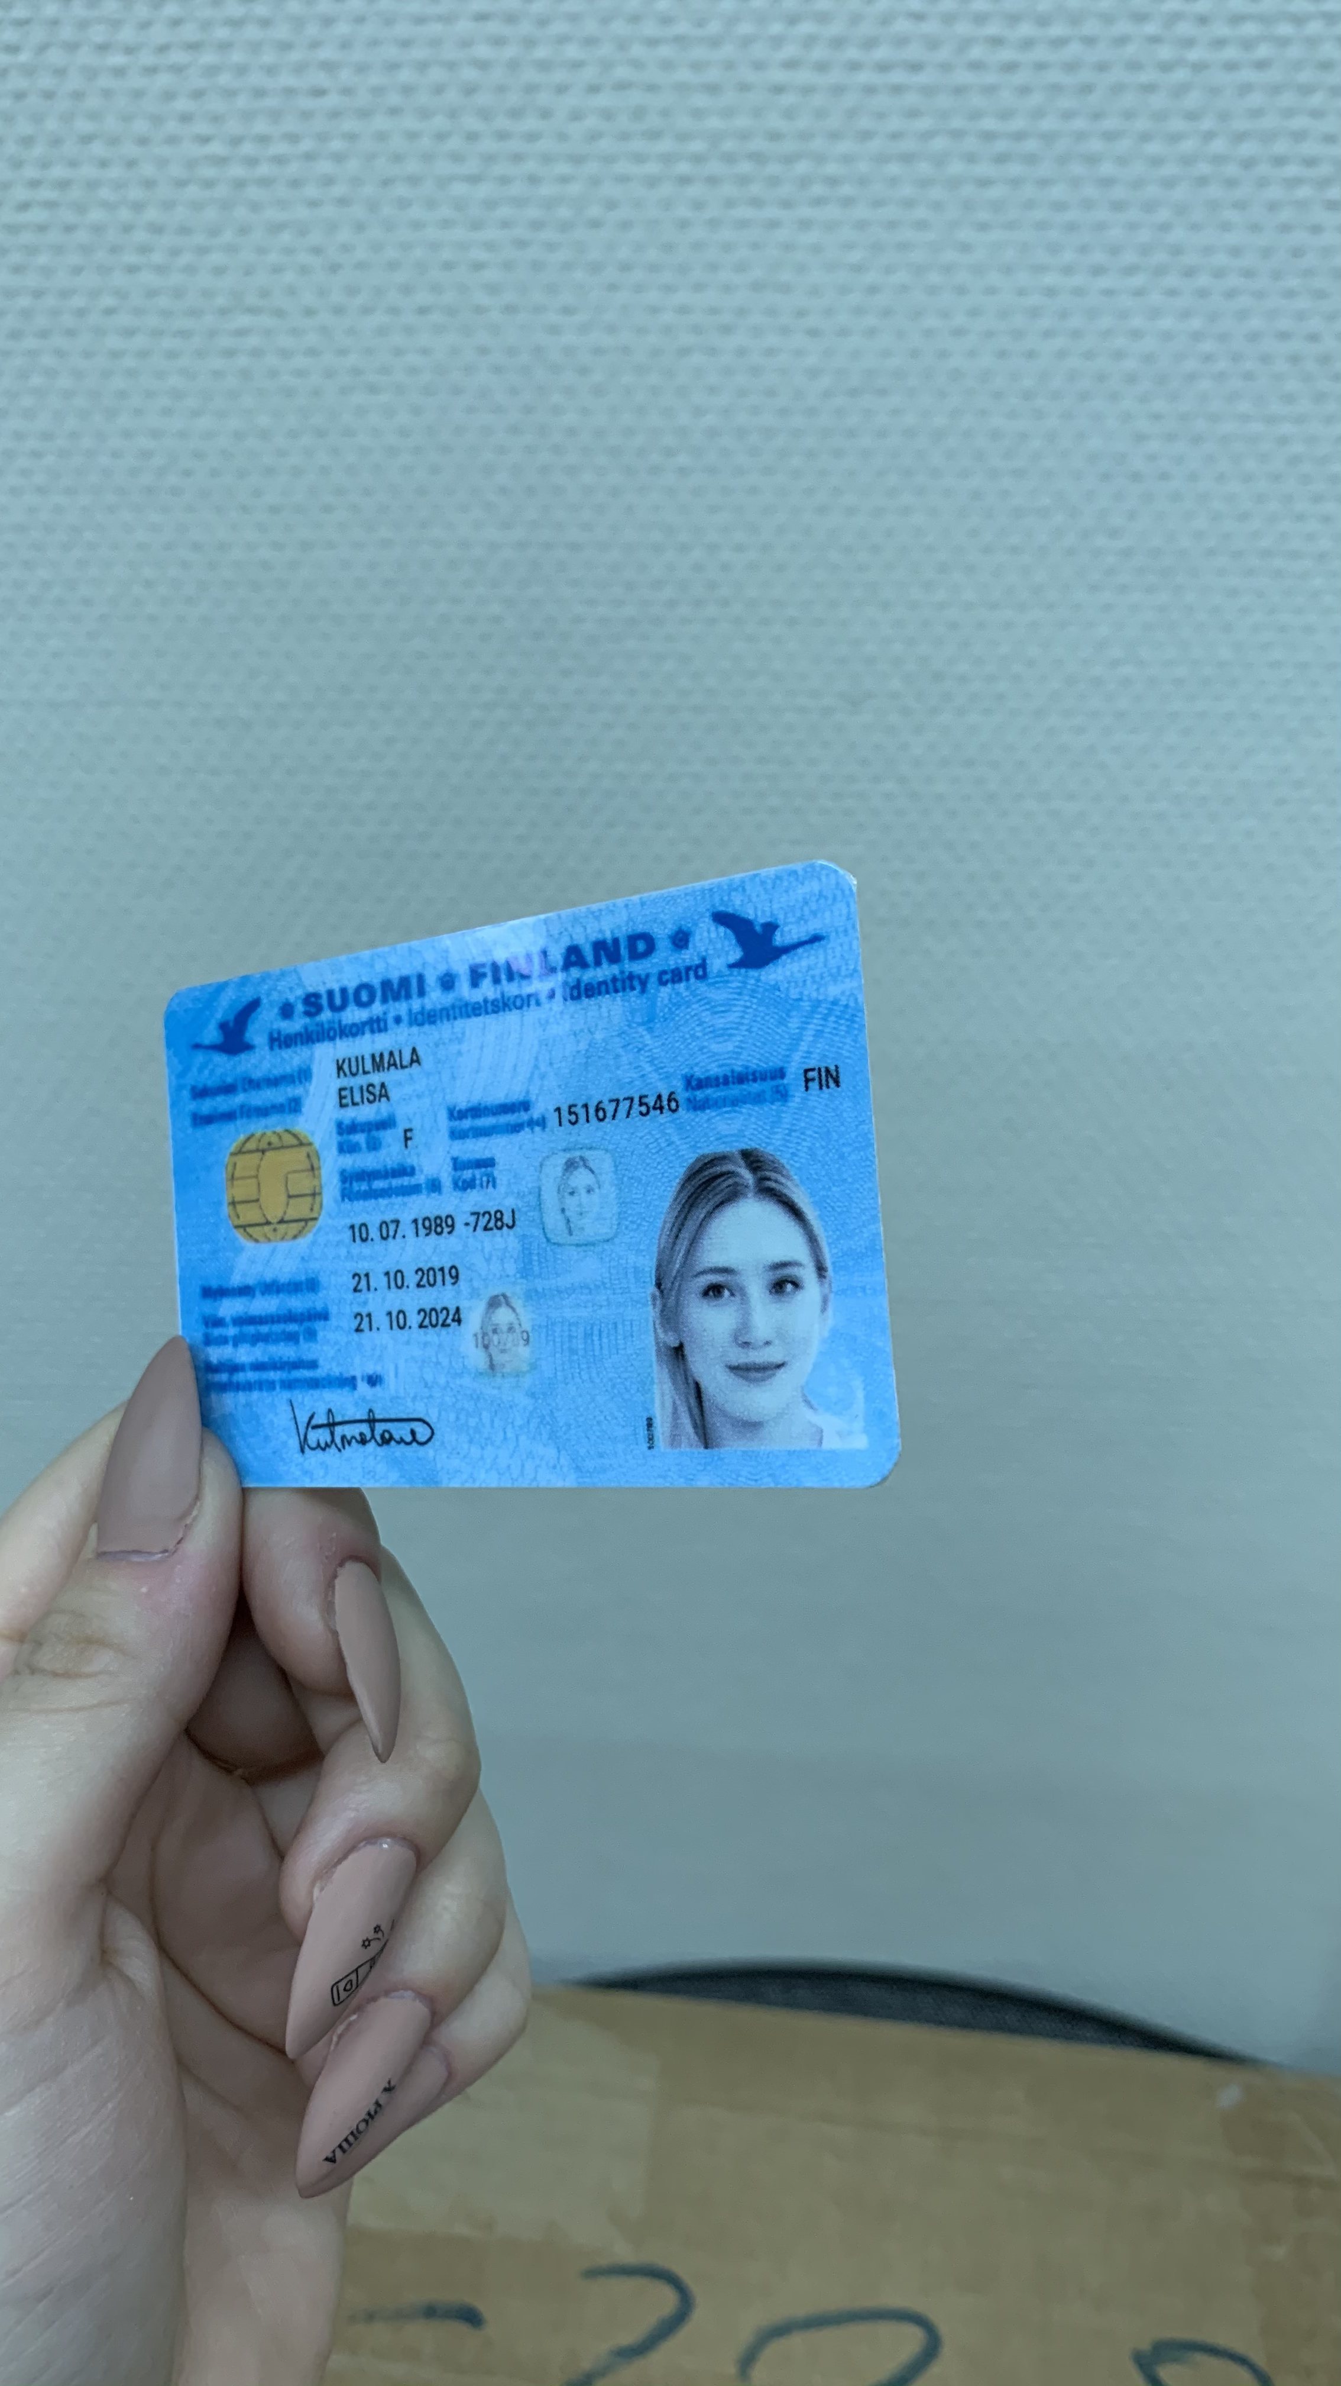
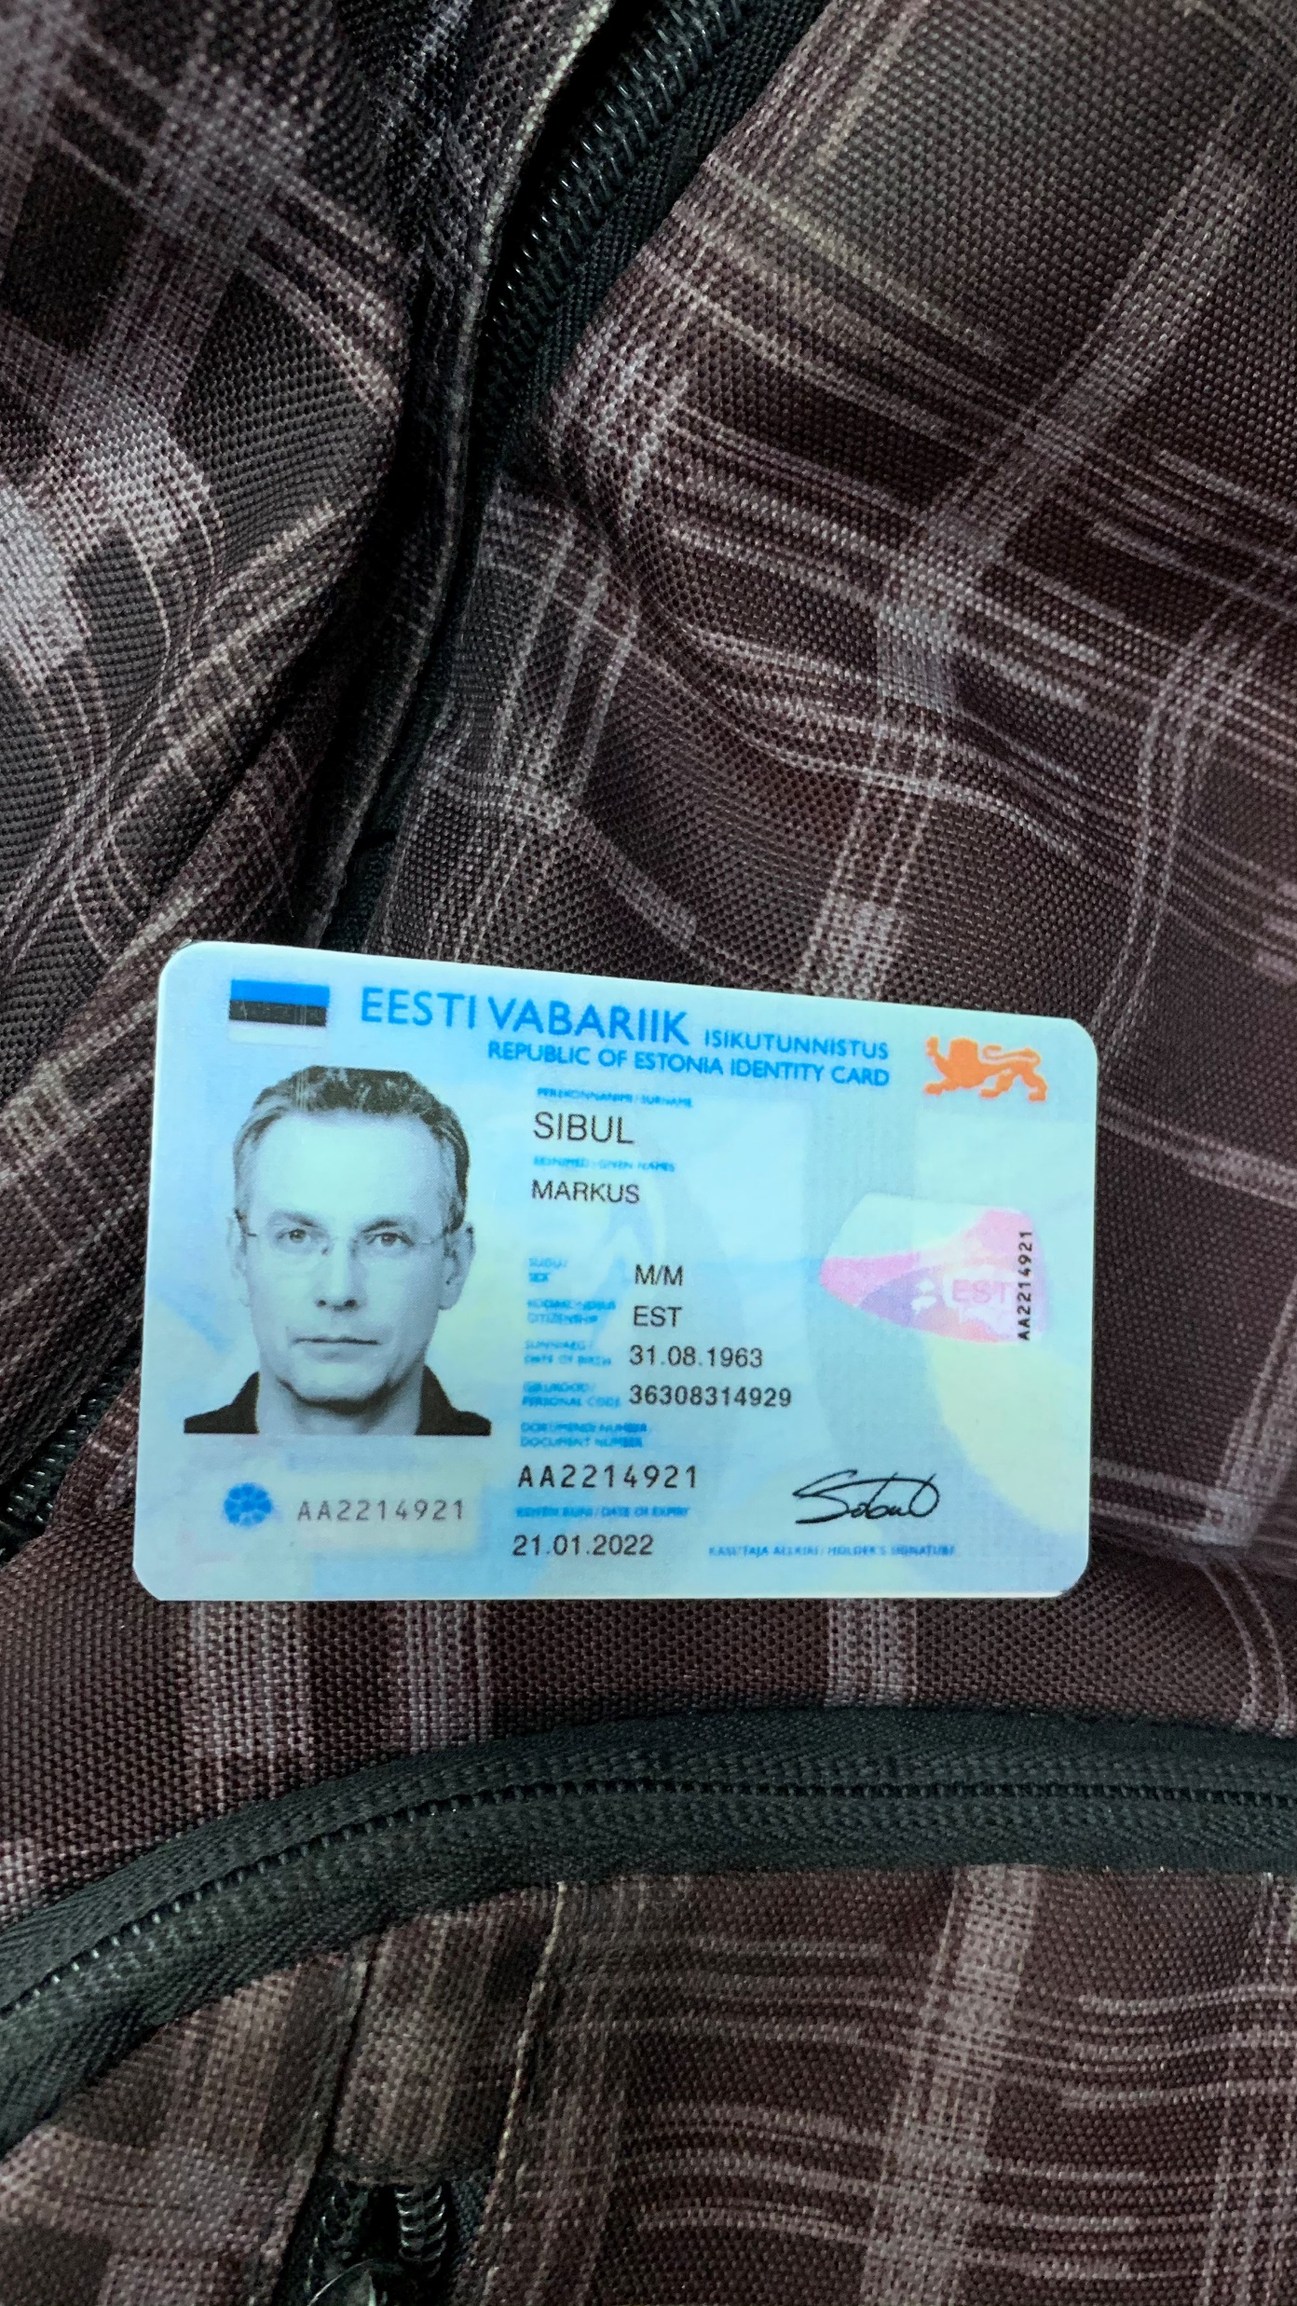
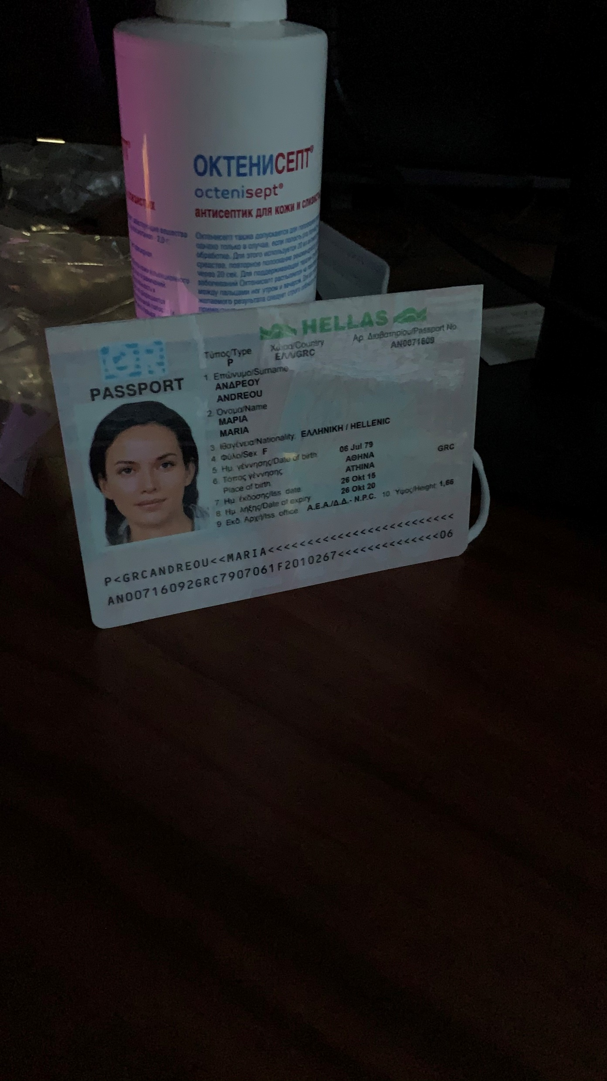
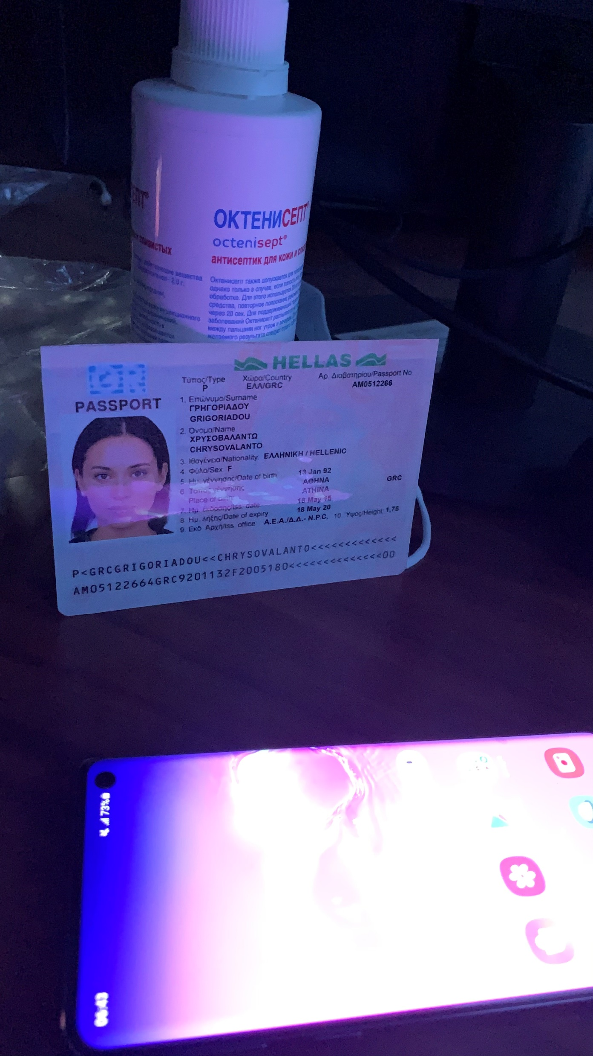
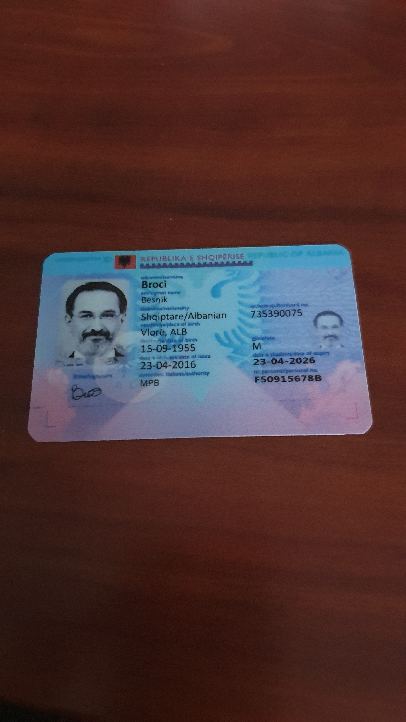
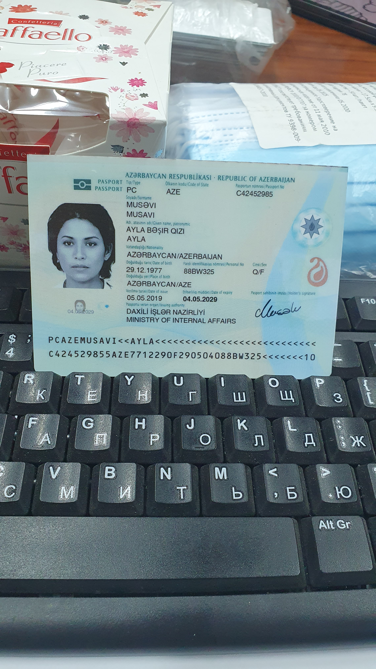
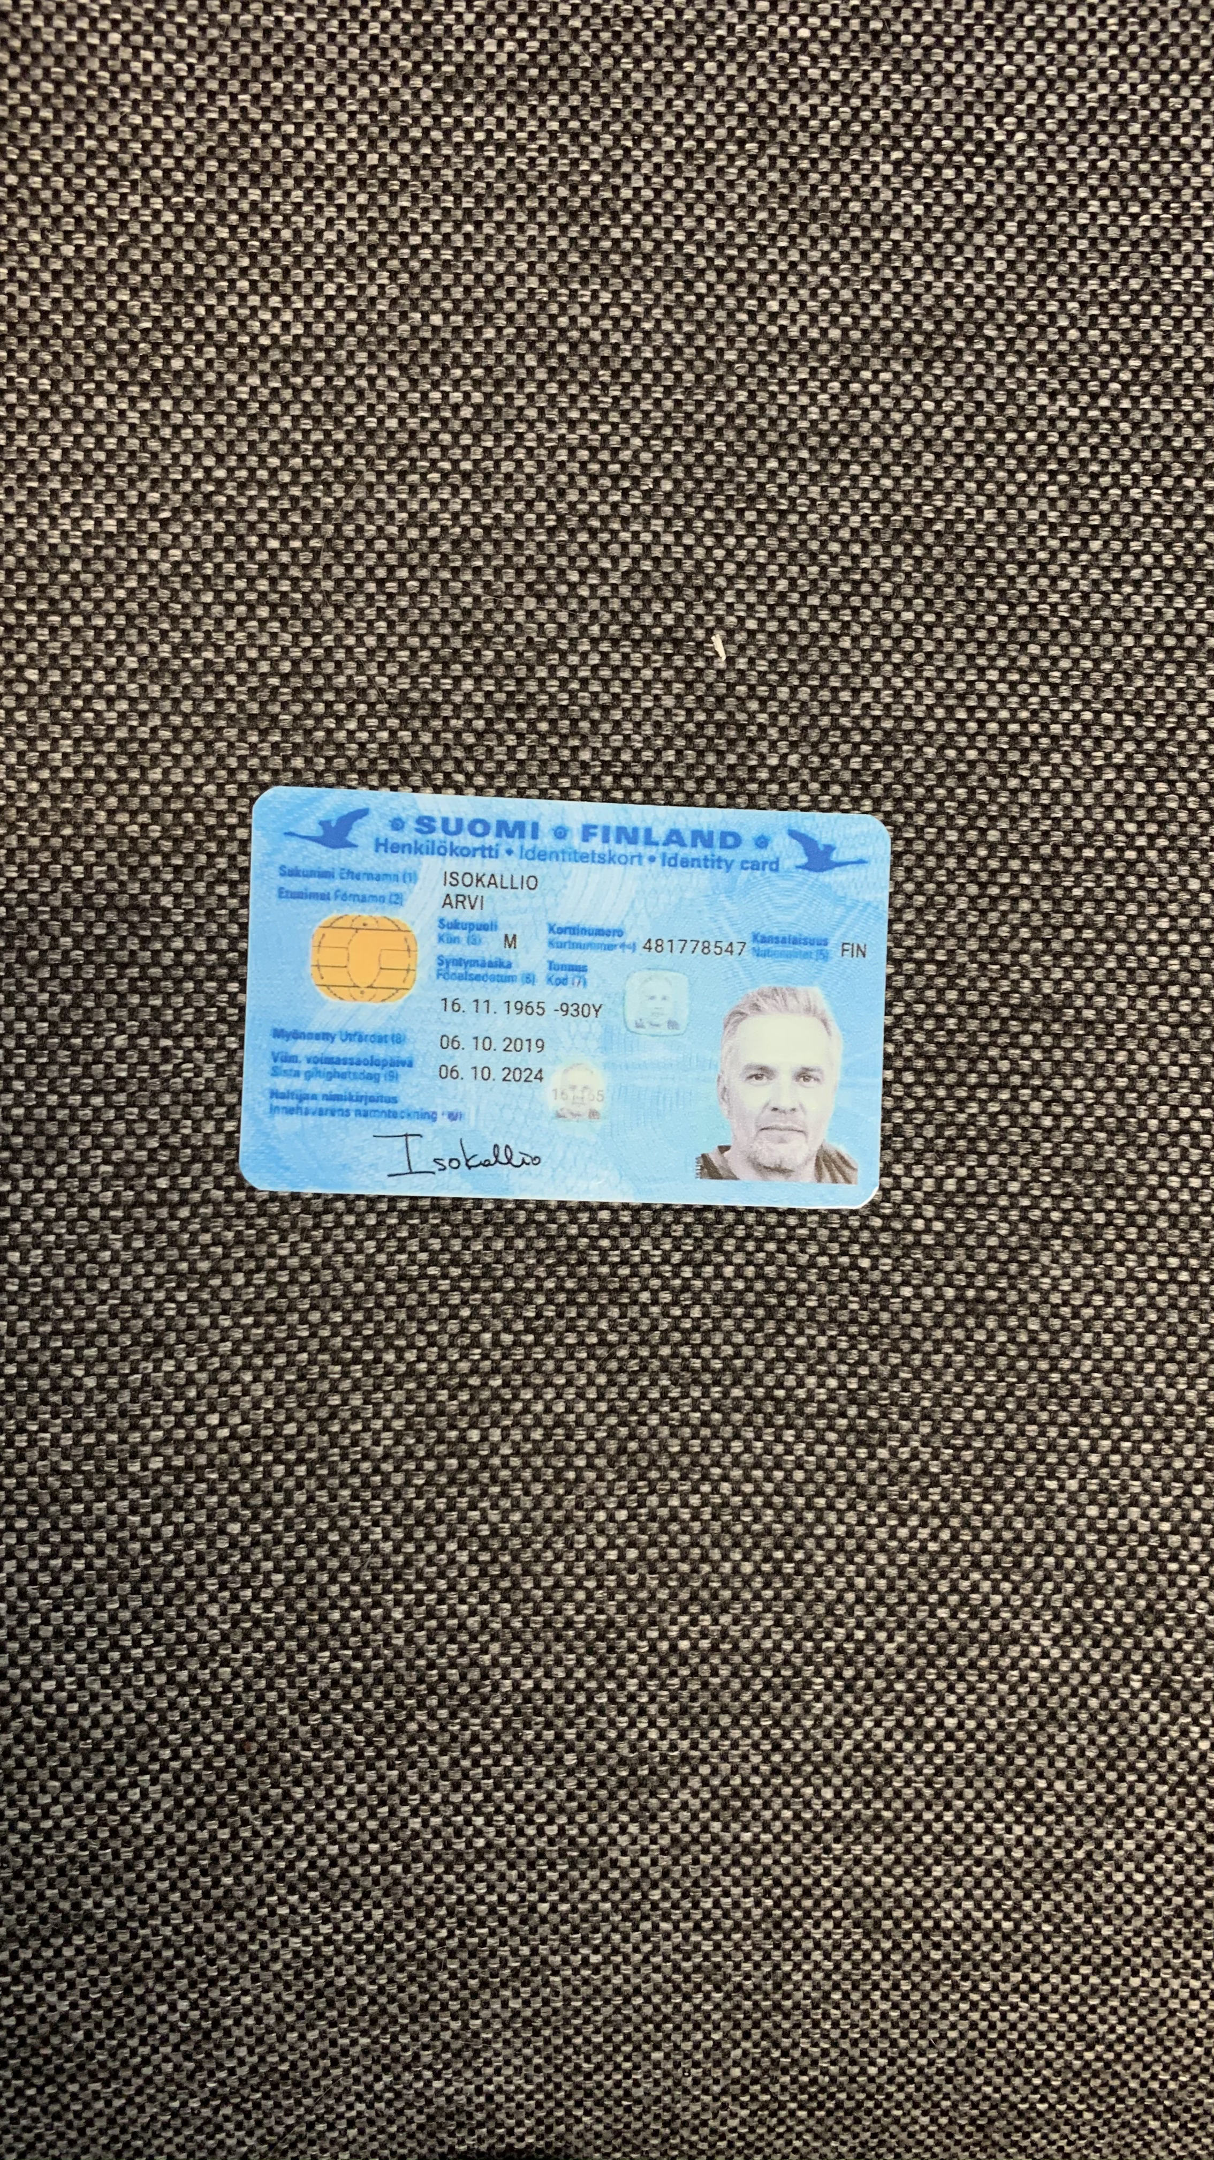
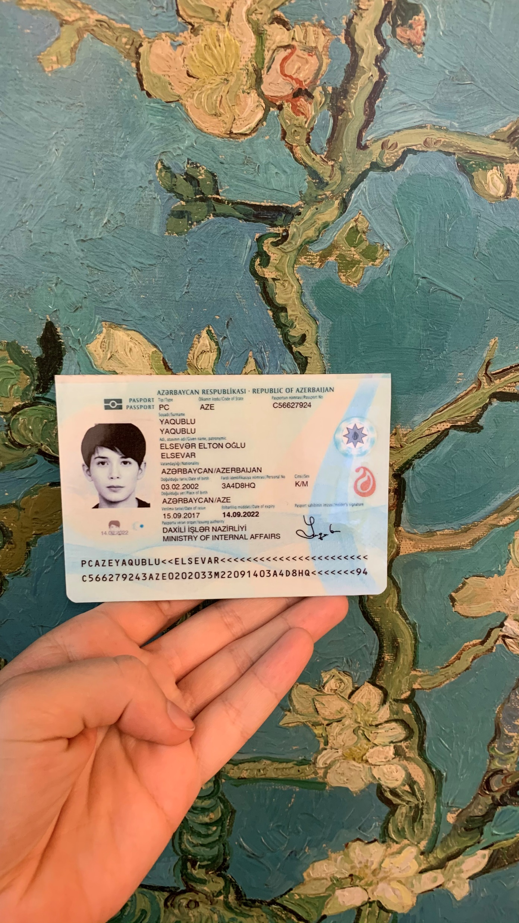
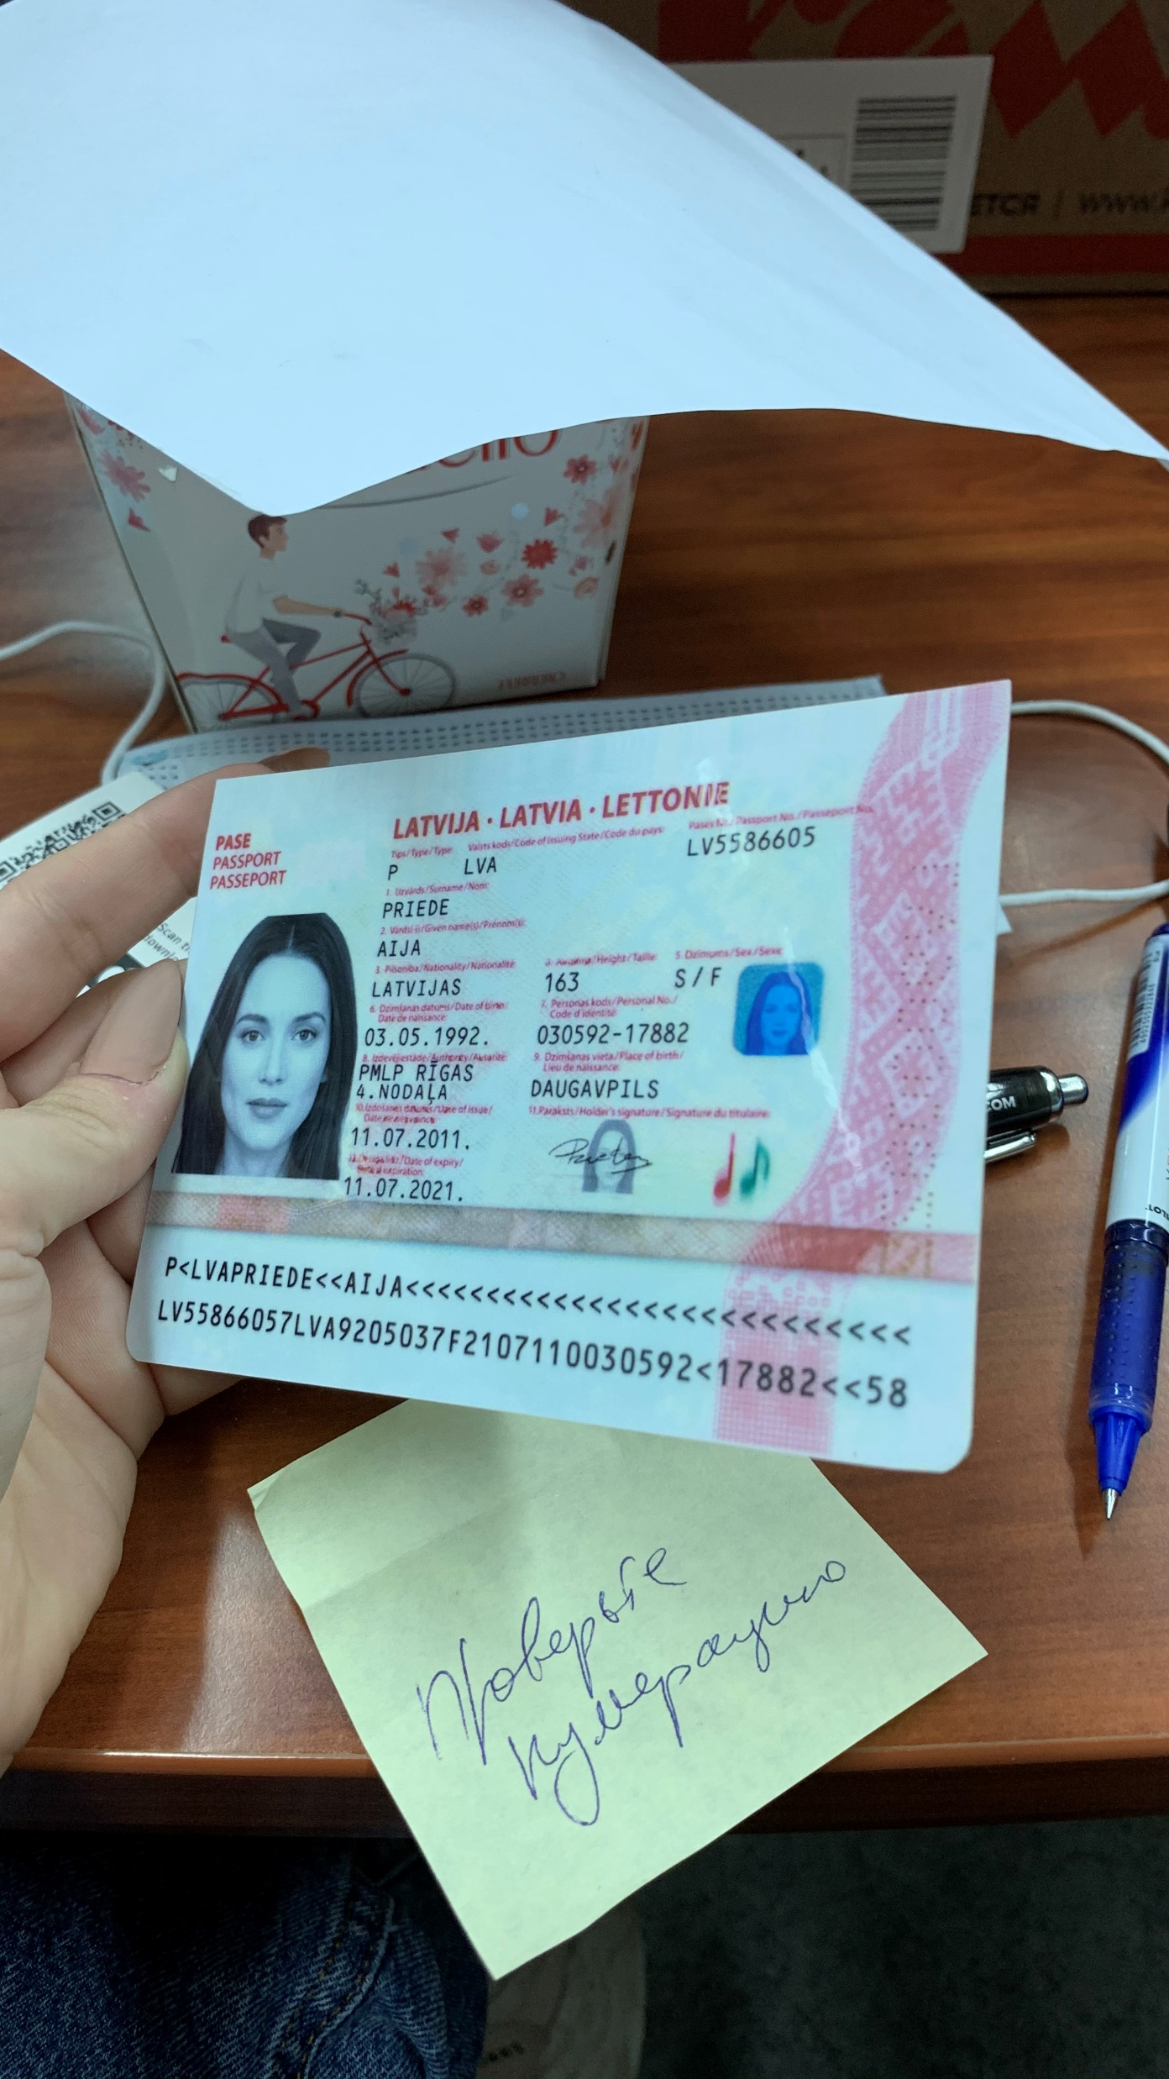
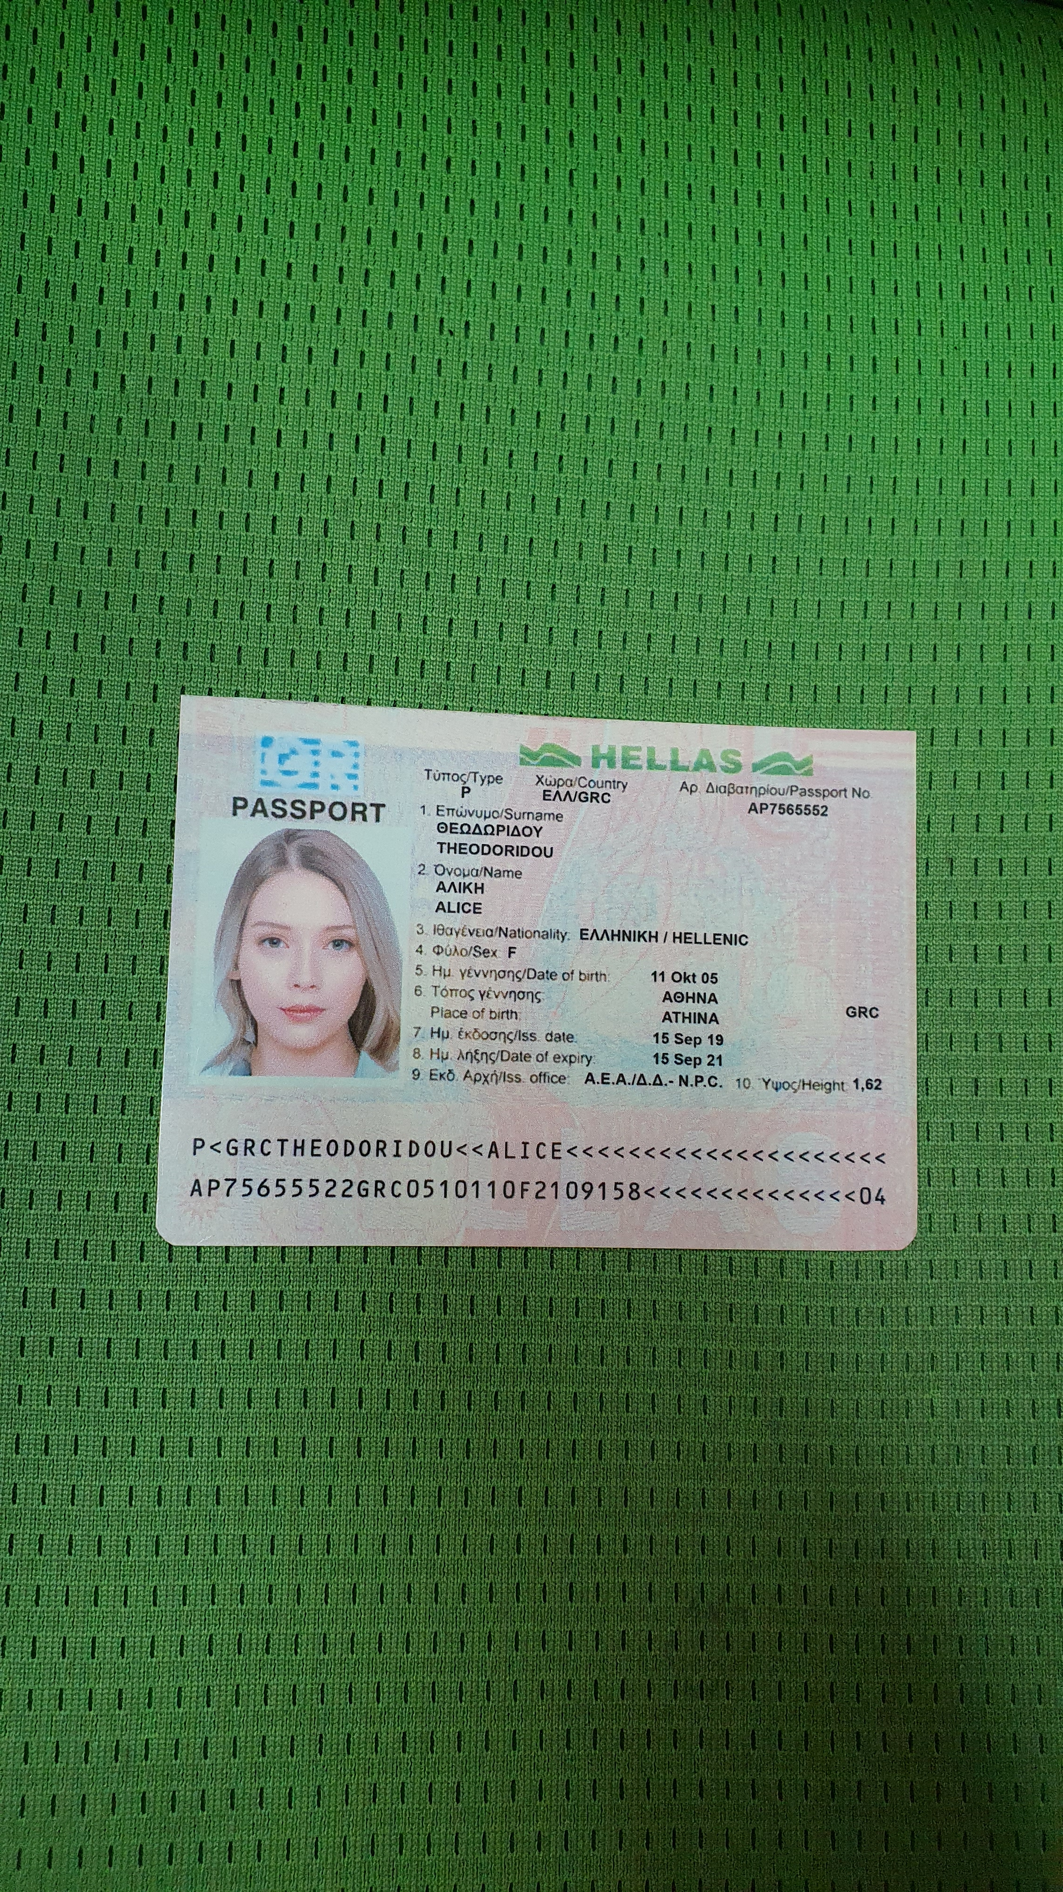
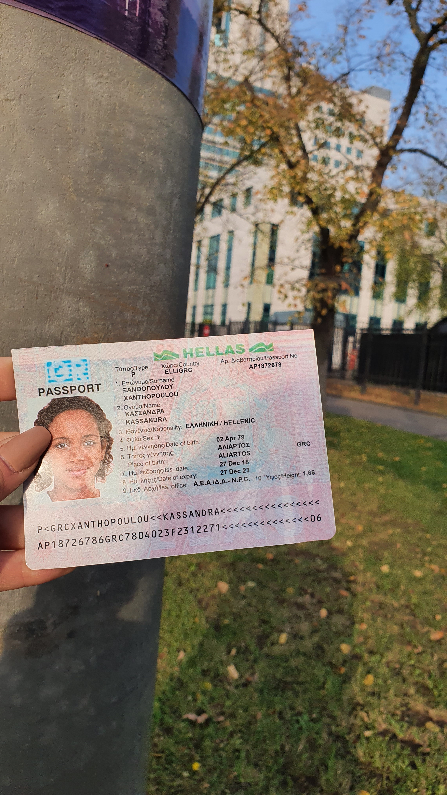
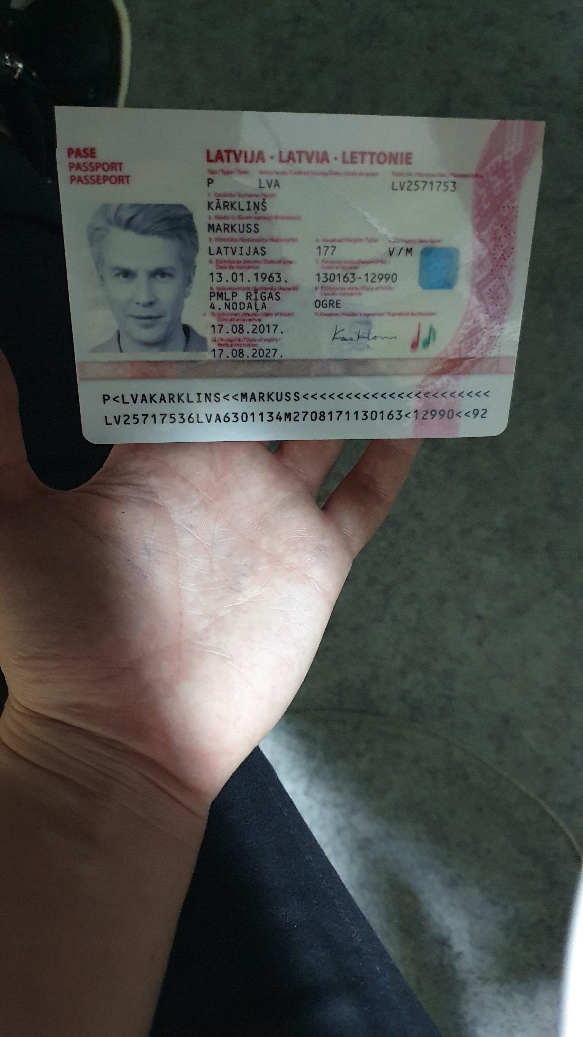
Dataset – Acceptable Photos*
Normal
Different background
Different brightness
*Already have: 1,000 samples

Slide 6
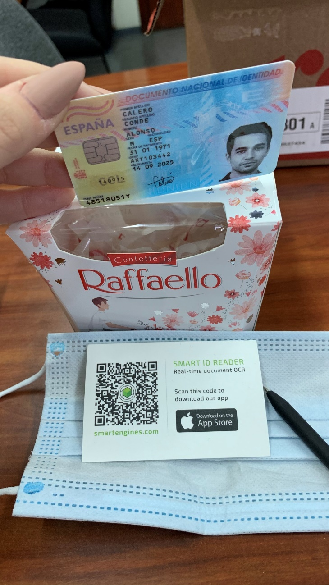
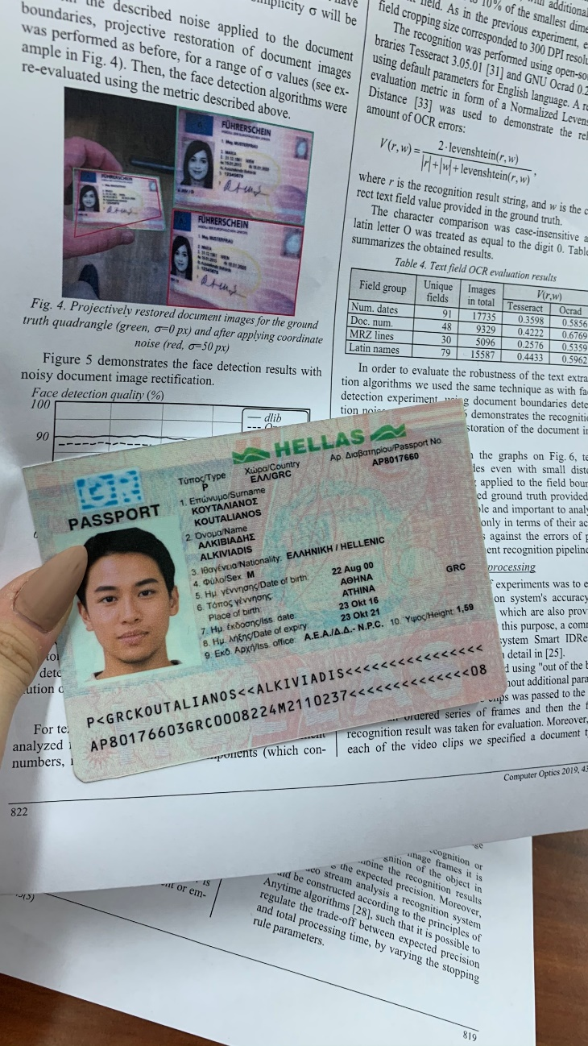
Dataset – Acceptable Photos
Multiple cards
Multiple IDs

Slide 7
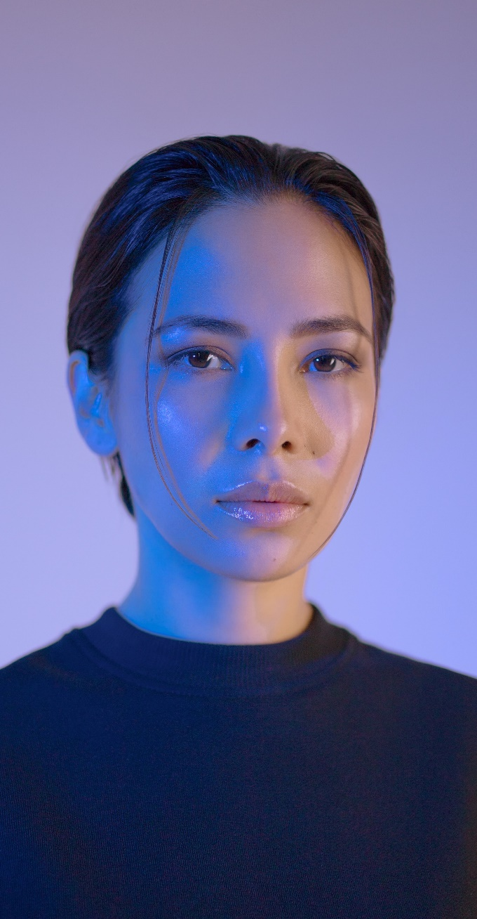
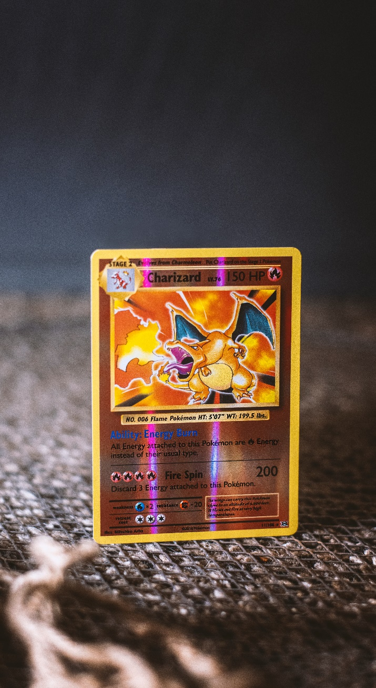
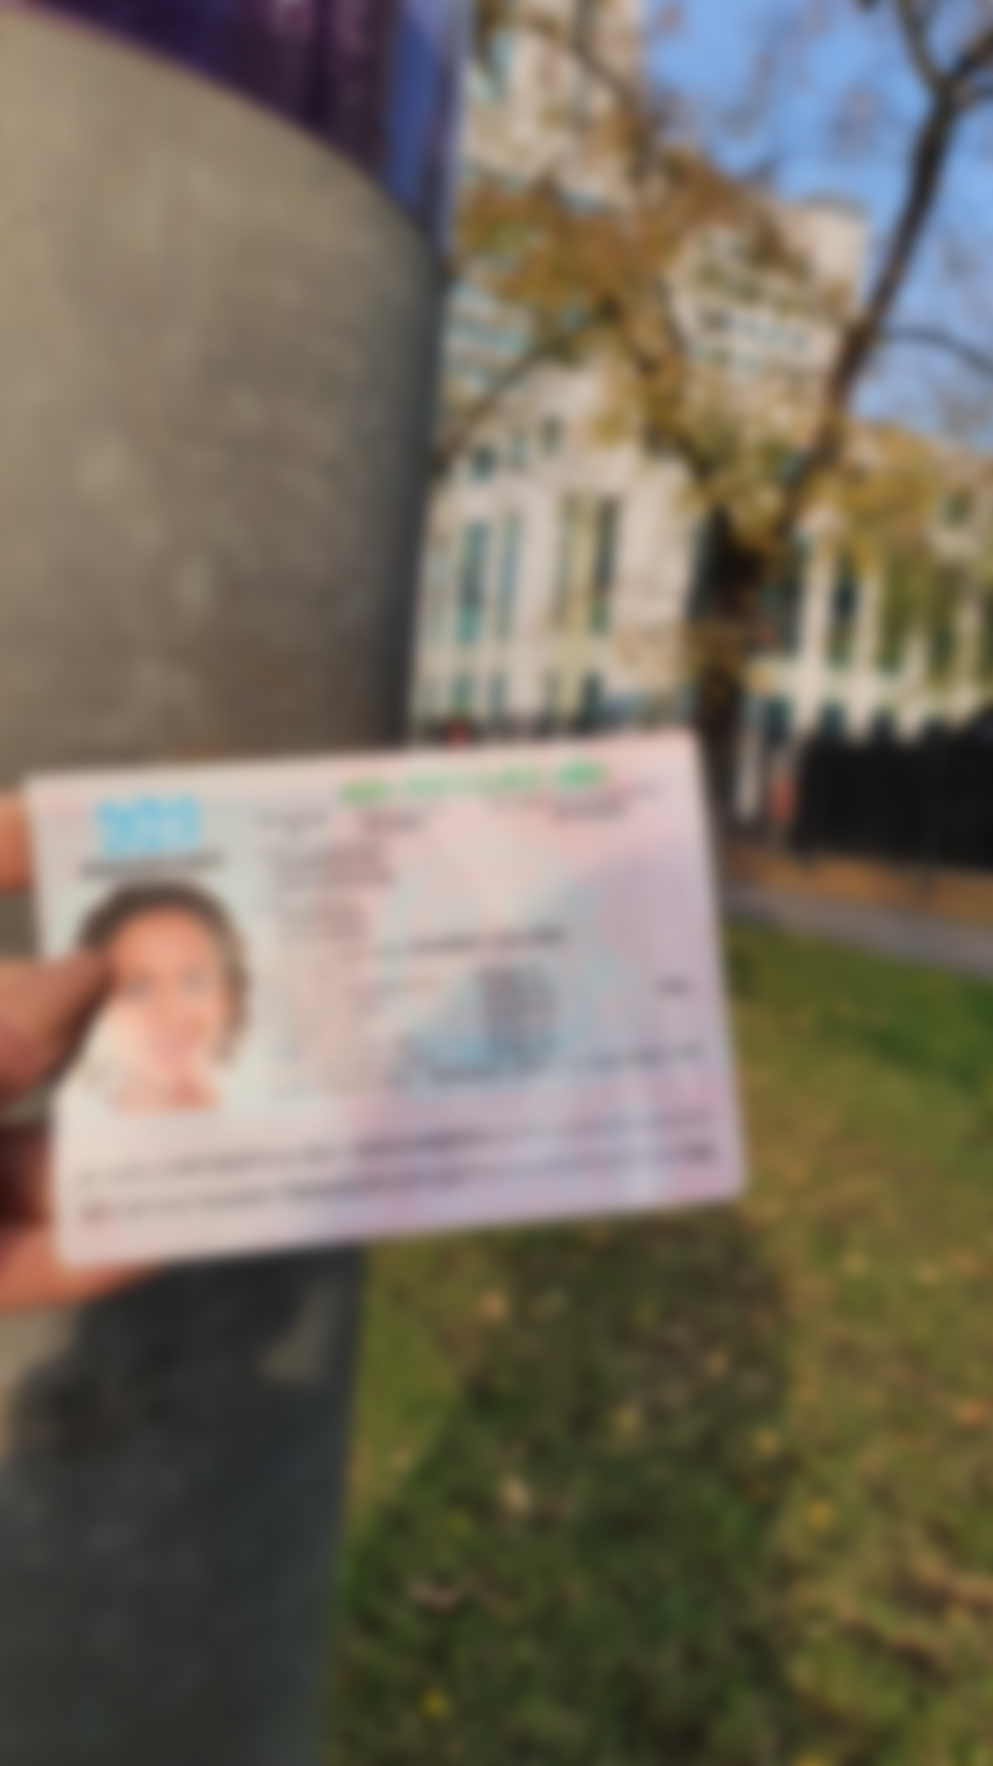
Dataset – Unacceptable Photos*
No Cards
Non-ID Cards
Too dark / bright
Blurred
*Need to generate: 1,000 for each class

Slide 8


User’s process
Digital bank’s process
Pass: proceed with account opening process
Customer wants to sign up for a digital bank account
Submits photo of ID card
Check if the details in ID is recognisable
Fails: route for
re-submission
Processing time: 3 – 5 working days
Reference: an incorrect photo submission to Singapore’s ICA may double the process time¹ (2 weeks for NRIC, 4 weeks for passport²)

Slide 9
User’s process
Digital bank’s process
Pass: proceed with account opening process
Customer wants to sign up for a digital bank account
Submits photo of ID card
Check if the details in ID is recognisable
Fails: route for
re-submission
When the user is positioning

Slide 10
User’s process
Digital bank’s process
Customer wants to sign up for a digital bank account
Submits photo of ID card
Check if the details in ID is recognisable
Pass: proceed with account opening process
Direct customer to use mobile app to take a photo. The app can provide real-time advice:
Image is too dark

Slide 11
02
Validating ID Submissions using Machine Vision
Improving the customer experience in applying for a new digital bank account

Slide 12
Minimalist Business Basic Template
Here is where your presentation begins

Slide 13
Contents of this template
You can delete this slide when you’re done editing the presentation
Fonts | To view this template correctly in PowerPoint, download and install the fonts we used
Used and alternative resources | An assortment of graphic resources that are suitable for use in this presentation
Thanks slide | You must keep it so that proper credits for our design are given
Colors | All the colors used in this presentation
Icons and infographic resources | These can be used in the template, and their size and color can be edited
Editable presentation theme | You can edit the master slides easily. For more info, click here
For more info: SLIDESGO | SLIDESGO SCHOOL | FAQs
You can visit our sister projects: FREEPIK | FLATICON | STORYSET | WEPIK | VIDEVO

Slide 14
Table of contents
01
02
03
Jupiter
Venus
Saturn
Jupiter is a gas giant and the biggest planet in the Solar System. It's the fourth-brightest object in the night sky. It was named after the Roman god of the skies and lightning
Venus has a beautiful name and is the second planet from the Sun. It’s terribly hot and its atmosphere is poisonous. It’s the second-brightest natural object in the night sky
Saturn is a gas giant and has rings. It's composed mostly of hydrogen and helium. It was named after the Roman god of wealth and agriculture. It’s the sixth planet from the Sun

Slide 15
01
Name of the section
You can enter a subtitle here if you need it

Slide 16

Our team
Mercury is the closest planet to the Sun and the smallest one in the entire Solar System. This planet's name has nothing to do with the liquid metal, since Mercury was named after the Roman messenger god. Despite being closer to the Sun than Venus, its temperatures aren't as terribly hot as that planet's. Its surface is quite similar to that of Earth's Moon
Speaking of craters, many of them were named after artists or authors who made significant contributions to their respective fields. Mercury takes a little more than 58 days to complete its rotation, so try to imagine how long days must be there! Since the temperatures are so extreme, albeit not as extreme as in Venus, and the solar radiation is so high, Mercury has been deemed to be non-habitable for humans

Slide 17
—Someone Famous
“This is a quote, words full of wisdom that someone important said and can make the reader get inspired.”

Slide 18
Maybe you need to divide the content
Jupiter and Mars
Venus and Mercury
Jupiter is a gas giant and the biggest planet in the Solar System. It's the fourth-brightest object in the night sky. It was named after the Roman god of the skies and lightning
Despite being red, Mars is actually a cold place. It's full of iron oxide dust
Venus has a beautiful name and is the second planet from the Sun. It’s terribly hot, even hotter than Mercury, and its atmosphere is extremely poisonous
Mercury is the closest planet to the Sun and the smallest one in the Solar System

Slide 19

You can use bullet points
Venus has a beautiful name and is the second planet from the Sun. It’s terribly hot, even hotter than Mercury, and its atmosphere is extremely poisonous. It’s the second-brightest natural object in the night sky after the Moon
Earth is the third planet from the Sun and the only one that harbors life in the Solar System. We all live on it!
Jupiter is a gas giant and the biggest planet in the Solar System. It's the fourth-brightest object in the night sky. It was named after the Roman god of the skies and lightning
Mercury is the smallest planet in the Solar System. It was named after the Roman messenger god
Despite being red, Mars is actually a cold place. It's full of iron oxide dust, which gives the planet its reddish cast

Slide 20
Infographics are always useful
01
02
03
04
Venus
Mars
Mercury is the smallest planet in the Solar System
Despite being red, Mars is a very cold place
Mercury
Jupiter
Venus is the second planet from the Sun
Jupiter is the biggest planet in the Solar System

Slide 21

A picture is worth a thousand words

Slide 22
Slide with longer text
Mercury is the closest planet to the Sun and the smallest of them all. This planet's name has nothing to do with the liquid metal, since Mercury was named after the Roman messenger god. Despite being closer to the Sun than Venus, its temperatures aren't as terribly hot as that planet's. Its surface is quite similar to that of Earth's Moon, which means there are a lot of craters and plains. Speaking of craters, many of them were named after artists or authors who made significant contributions to their respective fields. Mercury takes a little more than 58 days to complete its rotation, so try to imagine how long days must be there! Since the temperatures are so extreme, albeit not as extreme as in Venus, and the solar radiation is so high, Mercury has been deemed to be non-habitable for humans
Mercury is the closest planet to the Sun and the smallest of them all. This planet's name has nothing to do with the liquid metal, since Mercury was named after the Roman messenger god. Despite being closer to the Sun than Venus, its temperatures aren't as terribly hot as that planet's. Its surface is quite similar to that of Earth's Moon, which means there are a lot of craters and plains. Speaking of craters, many of them were named after artists or authors who made significant contributions to their respective fields. Mercury takes a little more than 58 days to complete its rotation, so try to imagine how long days must be there! Since the temperatures are so extreme, albeit not as extreme as in Venus, and the solar radiation is so high, Mercury has been deemed to be non-habitable for humans

Slide 23
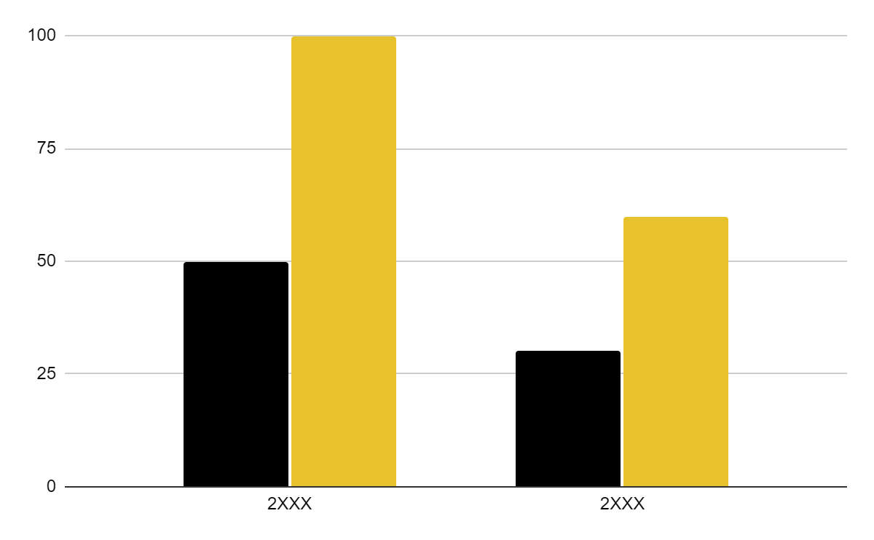
You can use this graph
Mercury
Jupiter
Mercury is the smallest planet of them all
Jupiter is the biggest planet of them all
Follow the link in the graph to modify its data and then paste the new one here. For more info, click here

Slide 24
Thanks!
Do you have any questions?
youremail@freepik.com
+34 654 321 432
yourwebsite.com
Please keep this slide for attribution

Slide 25
Alternative resources
Here’s an assortment of alternative resources whose style fits that of this template:

Slide 26
Resources
Did you like the resources on this template? Get them for free at our other websites:
Vectors
Lifestyle instagram post design template
Photos
Colleagues doing team work for a project I
Colleagues doing team work for a project II
Business woman banner concept with copy space

Slide 27
Instructions for use
If you have a free account, in order to use this template, you must credit Slidesgo by keeping the Thanks slide. Please refer to the next slide to read the instructions for premium users.
As a Free user, you are allowed to:
Modify this template.
Use it for both personal and commercial projects.
You are not allowed to:
Sublicense, sell or rent any of Slidesgo Content (or a modified version of Slidesgo Content).
Distribute Slidesgo Content unless it has been expressly authorized by Slidesgo.
Include Slidesgo Content in an online or offline database or file.
Offer Slidesgo templates (or modified versions of Slidesgo templates) for download.
Acquire the copyright of Slidesgo Content.
For more information about editing slides, please read our FAQs or visit Slidesgo School:
https://slidesgo.com/faqs and https://slidesgo.com/slidesgo-school

Slide 28
Instructions for use (premium users)
As a Premium user, you can use this template without attributing Slidesgo or keeping the Thanks slide.
You are allowed to:
Modify this template.
Use it for both personal and commercial purposes.
Hide or delete the “Thanks” slide and the mention to Slidesgo in the credits.
Share this template in an editable format with people who are not part of your team.
You are not allowed to:
Sublicense, sell or rent this Slidesgo Template (or a modified version of this Slidesgo Template).
Distribute this Slidesgo Template (or a modified version of this Slidesgo Template) or include it in a database or in any other product or service that offers downloadable images, icons or presentations that may be subject to distribution or resale.
Use any of the elements that are part of this Slidesgo Template in an isolated and separated way from this Template.
Register any of the elements that are part of this template as a trademark or logo, or register it as a work in an intellectual property registry or similar.
For more information about editing slides, please read our FAQs or visit Slidesgo School:
https://slidesgo.com/faqs and https://slidesgo.com/slidesgo-school

Slide 29
Fonts & colors used
This presentation has been made using the following fonts:
Playfair Display
(https://fonts.google.com/specimen/Playfair+Display)
Roboto
(https://fonts.google.com/specimen/Roboto)
#000000
#f0f0f0
#e7c22c
#ffffff

Slide 30



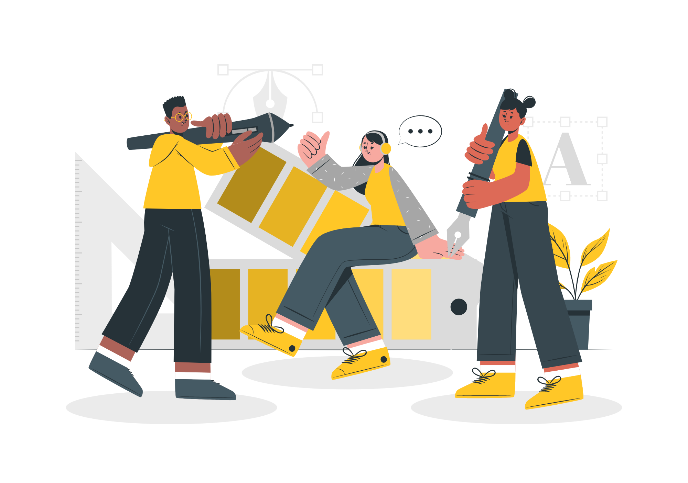

Storyset
Create your Story with our illustrated concepts. Choose the style you like the most, edit its colors, pick the background and layers you want to show and bring them to life with the animator panel! It will boost your presentation. Check out how it works.
Pana
Amico
Bro
Rafiki
Cuate

Slide 31
Use our editable graphic resources...
You can easily resize these resources without losing quality. To change the color, just ungroup the resource and click on the object you want to change. Then, click on the paint bucket and select the color you want. Group the resource again when you’re done. You can also look for more infographics on Slidesgo.

Slide 34
JANUARY
FEBRUARY
MARCH
APRIL
MAY
JUNE
PHASE 1
Task 1
Task 2
PHASE 2
Task 1
Task 2
JANUARY
FEBRUARY
MARCH
APRIL
PHASE 1
Task 1
Task 2

Slide 37
...and our sets of editable icons
You can resize these icons without losing quality.
You can change the stroke and fill color; just select the icon and click on the paint bucket/pen.
In Google Slides, you can also use Flaticon’s extension, allowing you to customize and add even more icons.

Slide 38
Educational Icons
Medical Icons

Slide 39
Business Icons
Teamwork Icons

Slide 40
Help & Support Icons
Avatar Icons

Slide 41
Creative Process Icons
Performing Arts Icons

Slide 42
Nature Icons

Slide 43
SEO & Marketing Icons

Slide 44


